Slide 1
The Future of Blockchain
By Paras Dalal

Slide 2
What Do I Plan to Cover
General concept of Blockchain
& How it is implemented
Common uses of Blockchain
Problems of Blockchain
Possible uses by us

Slide 3
General concept of Blockchain
Here is the definition as per Wikipedia
A blockchain is a growing list of records, called blocks, that are securely linked together using cryptography. Each block contains a cryptographic hash of the previous block, a timestamp, and transaction data (generally represented as a Merkle tree, where data nodes are represented by leafs). The timestamp proves that the transaction data existed when the block was published to get into its hash. As blocks each contain information about the block previous to it, they form a chain, with each additional block reinforcing the ones before it. Therefore, blockchains are resistant to modification of their data because once recorded, the data in any given block cannot be altered retroactively without altering all subsequent blocks.

Slide 4
General concept of Blockchain
Here is the definition as per Wikipedia
A blockchain is a growing list of records, called blocks, that are securely linked together using cryptography. Each block contains a cryptographic hash of the previous block, a timestamp, and transaction data (generally represented as a Merkle tree, where data nodes are represented by leafs). The timestamp proves that the transaction data existed when the block was published to get into its hash. As blocks each contain information about the block previous to it, they form a chain, with each additional block reinforcing the ones before it. Therefore, blockchains are resistant to modification of their data because once recorded, the data in any given block cannot be altered retroactively without altering all subsequent blocks.

Slide 5
General concept of Blockchain
Key Words:
Block
Data – Transactions, Timestamp, Previous block’s hash
Cryptography function
Hash
Distributed network

Slide 6
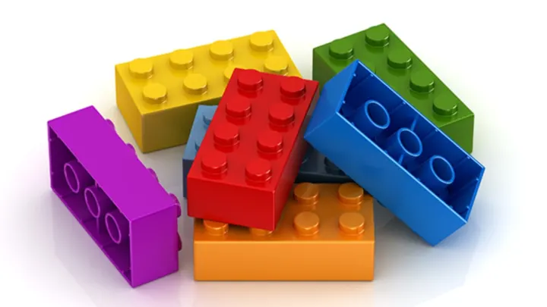

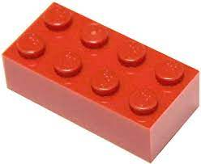

General concept of Blockchain
Cryptographic Function

Slide 7



General concept of Blockchain
Cryptographic Function
Slight Change in input will result in a totally different hash

Slide 8



General concept of Blockchain (mining)
Nonce
Cryptographic Function
Proof of Work
Notes:
Proof of work here is relevant for Bitcoin
There can be different kind of proofs – Proof of stake, Proof of storage (Filecoin)

Slide 9



General concept of Blockchain
Distributed Network of Nodes
Immutability

Slide 10
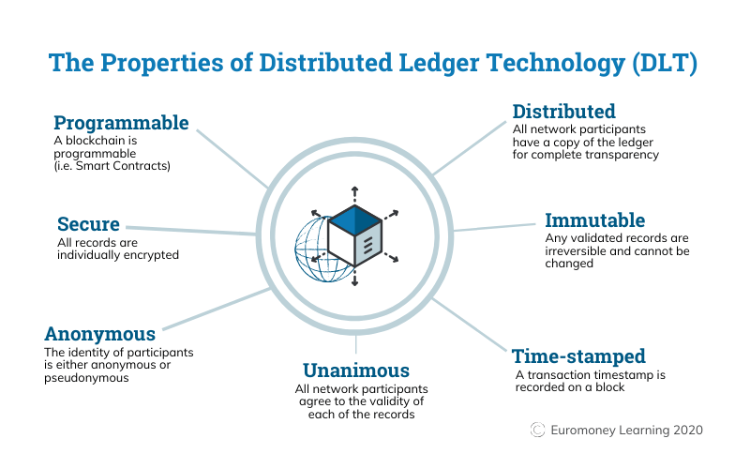
General concept of Blockchain
Blockchain is a type of Distributed Ledger Technology

Slide 11
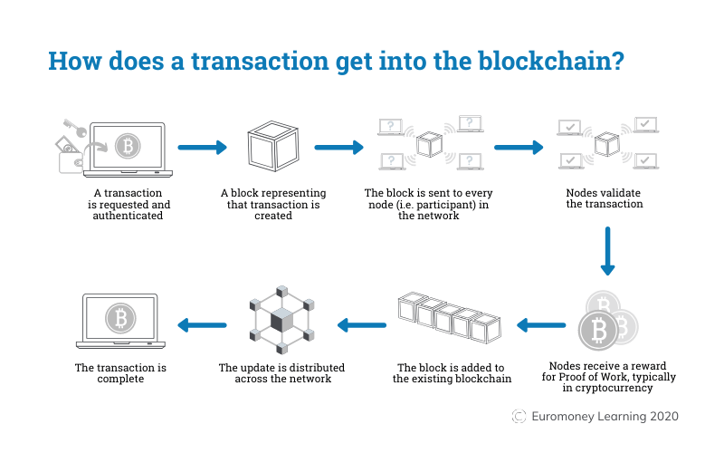
General concept of Blockchain

Slide 12
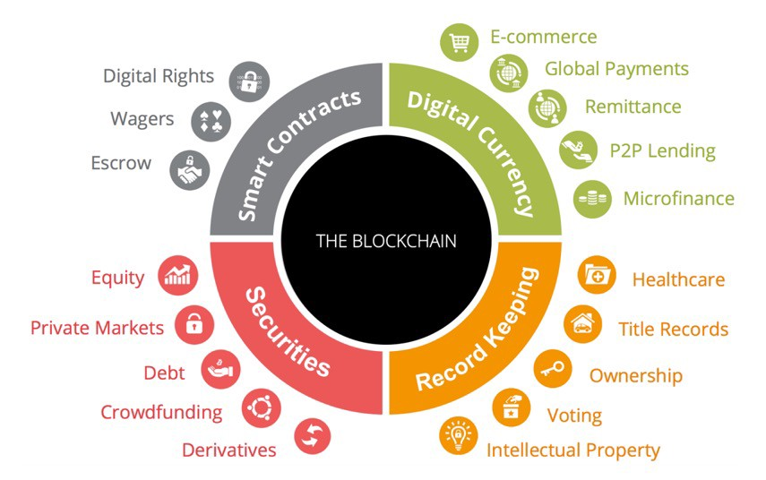
Common uses of Blockchain

Slide 13
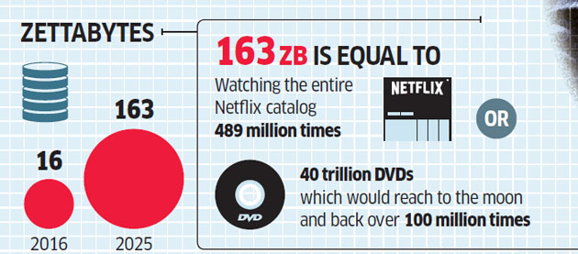
Common uses of Blockchain (Large Data)
Data Overflow
1,000,000,000,000,000,000,000 (10²¹ = 1 Billion Terabytes)
Notes:
Example is FileCoin (Sia.tech)

Slide 14

Common uses of Blockchain (immutability)
Data Security

Slide 15
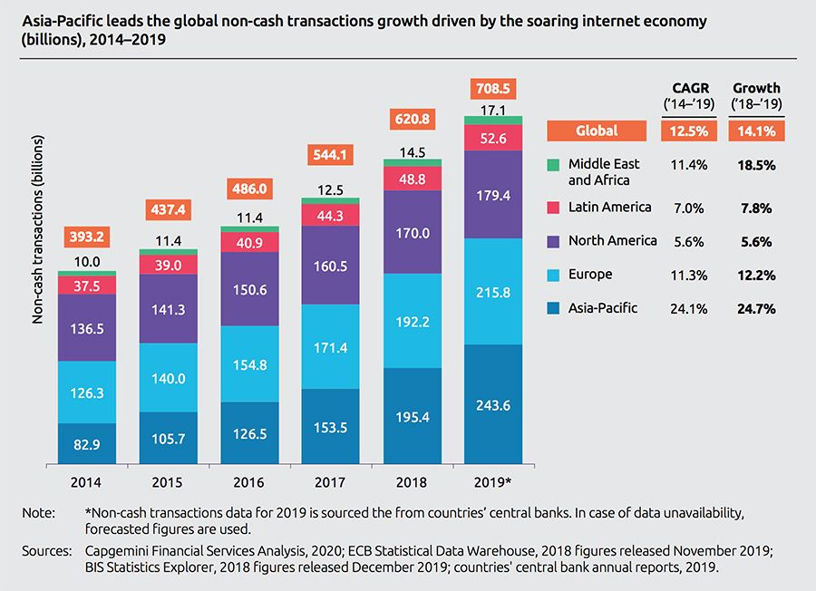
Common uses of Blockchain (Secure transactions)
Transactions

Slide 16
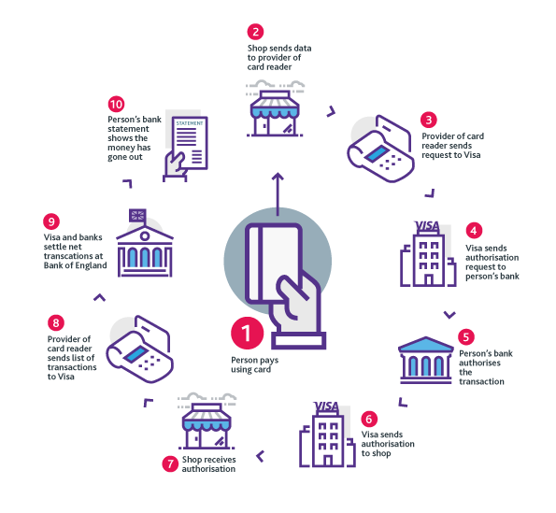
Common uses of Blockchain (Removal of Central Agency)
Intermediaries

Slide 17
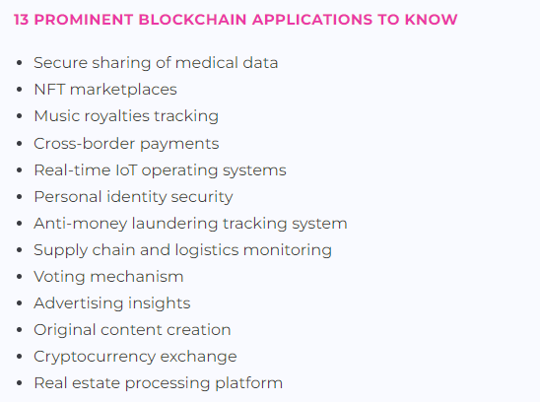
Common uses of Blockchain

Slide 18
Problems of Blockchain
Very new development, so monitoring agencies have not developed sufficient standards
Proof of work requires large use of electricity
For smaller network of Blockchain, if a single entity holds more than 50% of network nodes, transaction integrity can be affected
Since the transactions are done with public/private key usage, actual entity doing transaction(s) can be hidden (potential misuse for illegal purposes)
Large network makes the speed of transactions slow

Slide 19
Possible uses by us
May need to participate in public blockchain for settlement processing (Settlement using smart contracts – zero day settlement period)
May need to be aware of the crypto positions of our clients
Our clients may invest into digital assets and we need to be aware of underlying technology to guard their interests

Slide 20


